Slide 1
Earthquake Simulation Model using different Scheduling Algorithms
Rishi Dinesh, 19BAI1009
Pranav Balaji, 19BAI1151

Slide 2
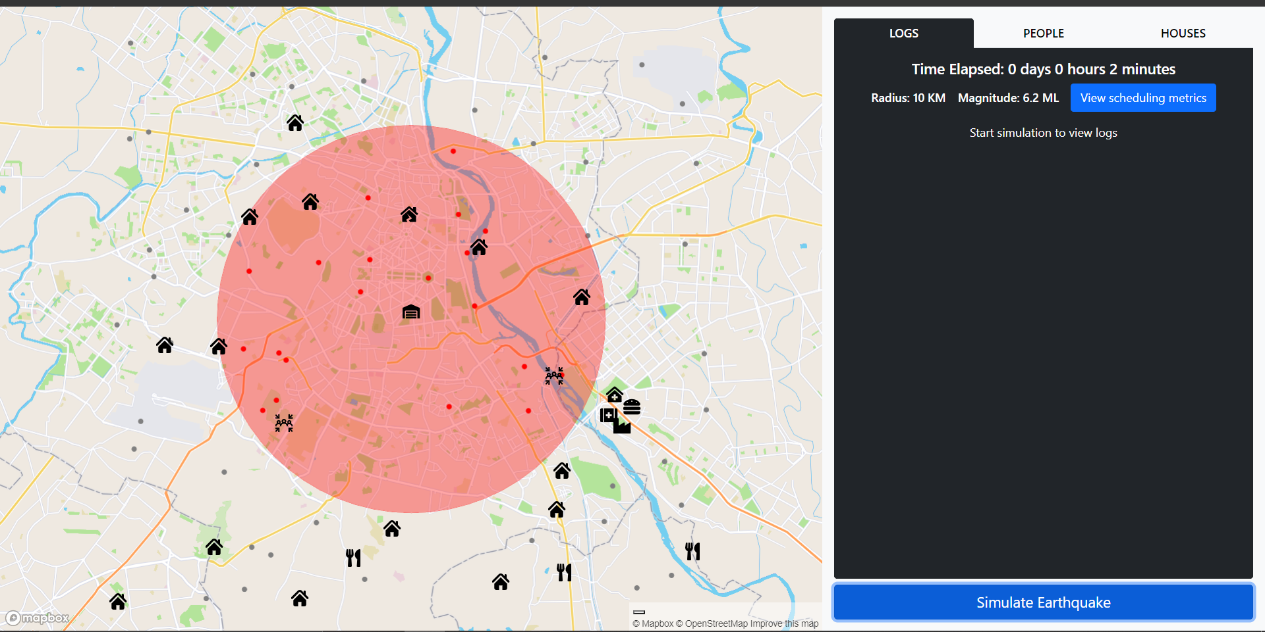
Algorithms used
Shortest Job First
Round Robin
First-come First-serve
Priority
Scheduling metrics
Waiting time
Turnaround time
Completion time
Stages of the Model
Initialization
Evacuation
First-aid
Medical attention
Food collection
Food distribution
Damage inspection
Rebuilding and Reallocation

Slide 3
Evacuation - SJF
Randomly generate N evacuation points.
Signal the relief camp for evacuation (arrival time) once the limit is reached.
Burst time is the straight line distance from the first-aid camp.
Initialization
Magnitude between 7 and 10.
Radius of the red zone is proportional to the magnitude of the earthquake.
Medical - Priority
Burst time is calculated as (100-x)*t2 where x is the health when they arrive at the medical camp and t2 is the time taken to boost the health by 1 point.
Priority is calculated as a combination of the person’s health status, age and gender.
First-Aid - RR
Arrival time is the time when people arrive at the camp.
Burst time is calculated as (x*t1)/2 where x is the health when they arrive at the camp and t1 is the time taken to boost the health by 1 point,

Slide 4
Food Distribution - Priority
When a person is fully nursed back to health at the medical camp, he/she will move to the food distribution center (arrival time).
The burst time of each person is a representative of his/her hunger level. Hunger level is calculated as (100-x) *h where x is the original health level after the earthquake hit and h is the amount of energy the person needs to absorb 1 health point obtained at the medical and first-aid camp.
Food Collection - SJF
Randomly setup N food centers on the map. When a food source is setup, it will send a signal indicating its ready state (arrival time). Obtain these food source in a shortest-distance fashion.
Inspection - FCFS
Arrival time could be the time at which the debris surrounding the property is cleared and the property sends a signal indicating that it is open for inspection.
Burst time is its distance from the epicenter. When a signal is received, an inspector from the inspection camp visits the property to assess the damage.
Rebuilding and Reallocation - SJF
If the damage points are greater than 50, the property is scheduled for patch up work and the residents are temporarily reallocated.
Burst time is calculated as (x-50)*t3 , where x is the damage level and and t3 is the time to fix 1 damage point.

Slide 5
Parameters of the model
Health Drop Rate
T1 | 10 minutes
T2 | 15 minutes
Population
6-7 | 40
7-8 | 60
8-9 | 80
9-10 | 100
Houses
6-7 | 10
7-8 | 15
8-9 | 20
9-10 | 25
Area of Red Zone
6-7 | 10Km
7-8 | 20Km
8-9 | 30Km
9-10 | 40Km
Initial Health
6-7 | 30-40
7-8 | 20-30
8-9 | 10-20
9-10 | 0-10
Evacuation Centers
6-7 | 2
7-8 | 3
8-9 | 4
9-10 | 5
Buffer time | 10 minutes
First Aid - Round Robin
Time Quantum | 10 minutes
t1 | 5 minutes
Medical - Priority
Priority | F
T | 10 minutes
Food Collection - SJF
6-7 | 3
7-8 | 4
8-9 | 5
9-10 | 6
Food Distribution - Priority
Priority | F
h | F
Rebuilding and Reallocation - Priority
t3 | 30 minutes

